Slide 1
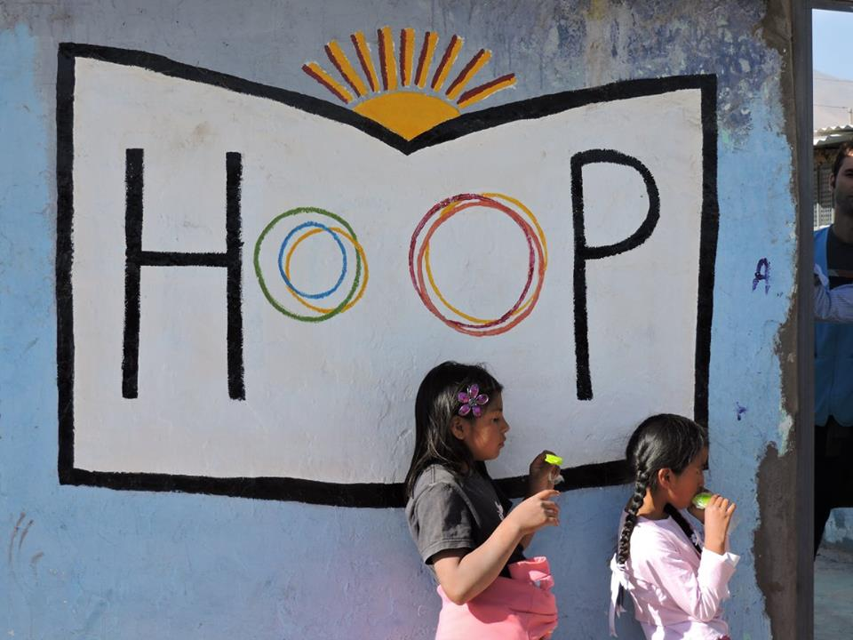
Kate Emery
Former volunteer HOOP Peru

Slide 2
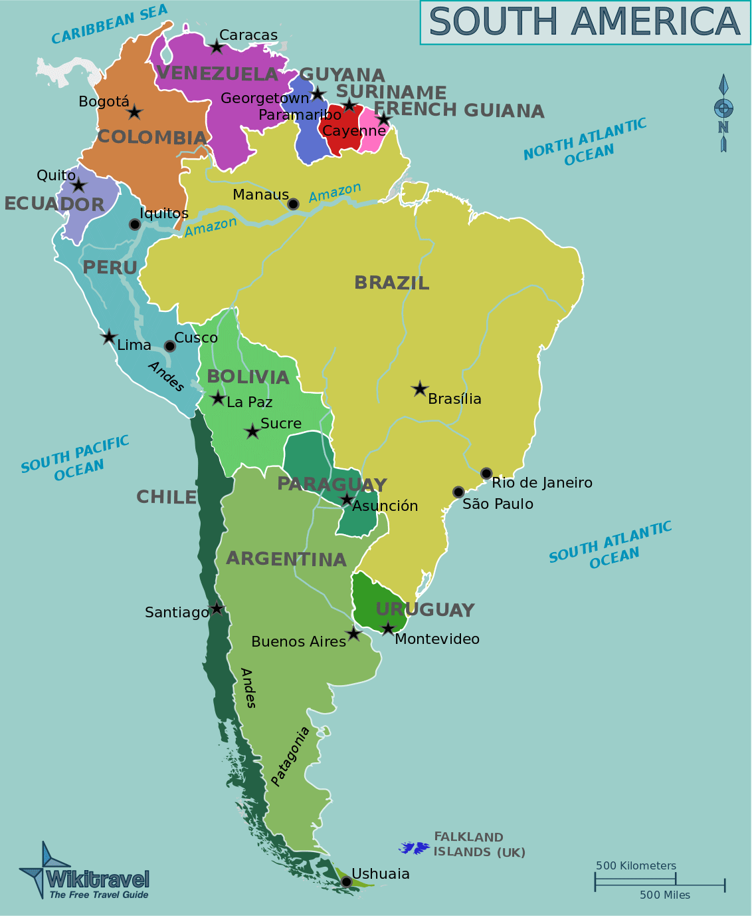
Why HOOP and Arequipa?
Long wanted to travel in South America
Liked what the charity stood for
Wanted to go somewhere where there would be other volunteers
“Perfect” climate
Notes:
I had wanted to travel around South America ever since I spent a month in Mexico as part of a 6 month trip in 2004.
When I was made redundant, it was the perfect opportunity to have a break between jobs and tie in volunteering with some travel

Slide 3
How did my previous experience benefit me in what I was asked to do?
Most recently my work has been business partnering so used to explaining financial concepts to non-financial staff
HOOP have no specific Finance staff, only 2 FT and 2 PT paid members of staff
A previous volunteer had set up a spreadsheet for accounting
Helped develop the spreadsheet to include all income sources
Wrote set of financial procedures and processes
Worked with the Director on the budget for new year
Got involved in all kinds of other activities, including selling charity Xmas cards, teaching a lesson and supervising 20 small children during a parents meeting

Slide 4
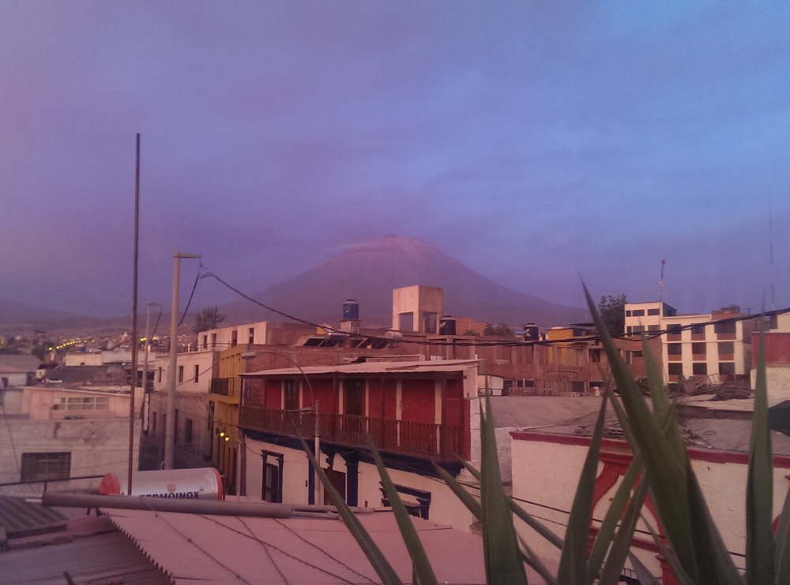
A typical day at HOOP
Breakfast on the rooftop terrace at Home Sweet Home

Slide 5
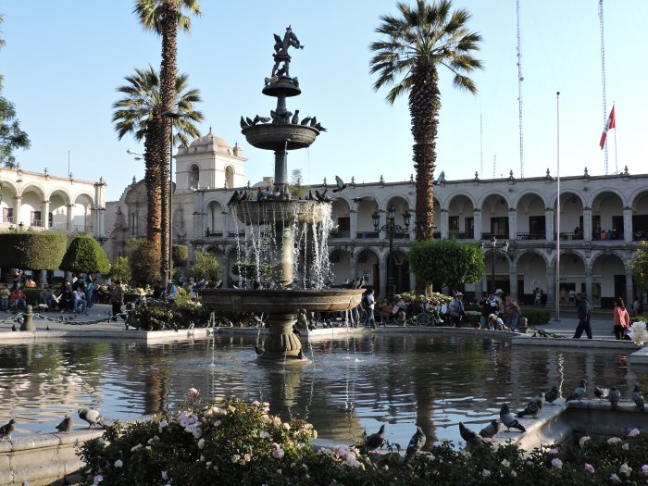
Walk to the office with other volunteers, or two days a week go for Spanish lessons before going to work

Slide 6
Working with Ali on the Budget

Slide 7
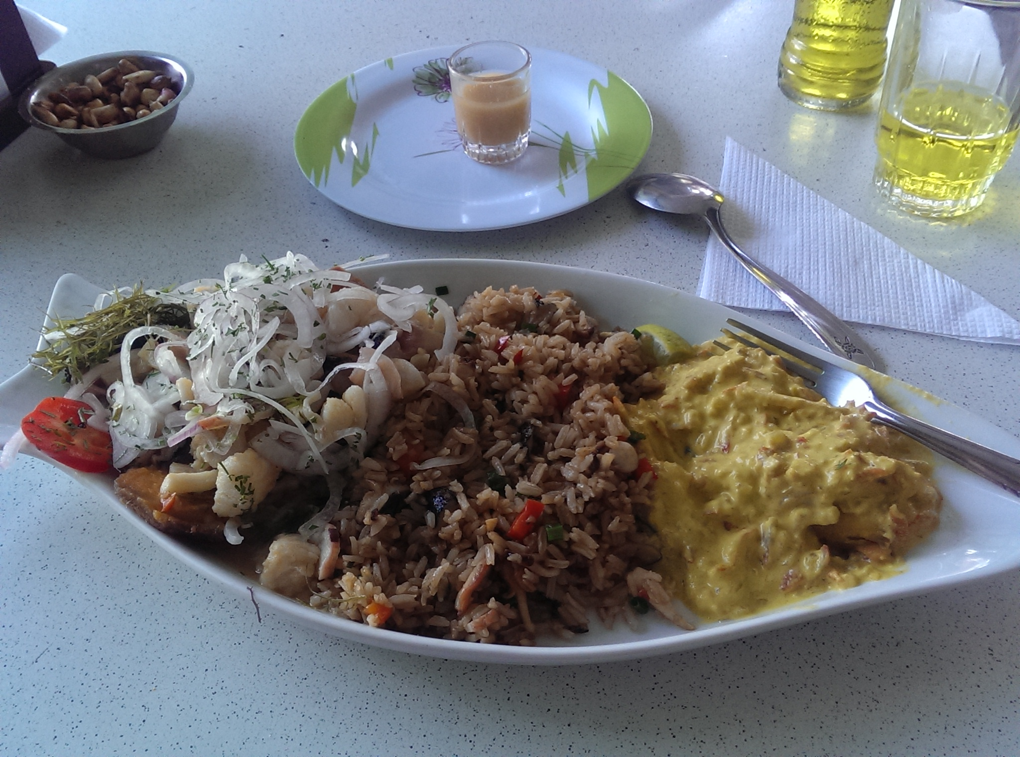
Go to a local restaurant for lunch, often for a lunch deal of soup, meat and veg then a jelly dessert, or for ceviche

Slide 8
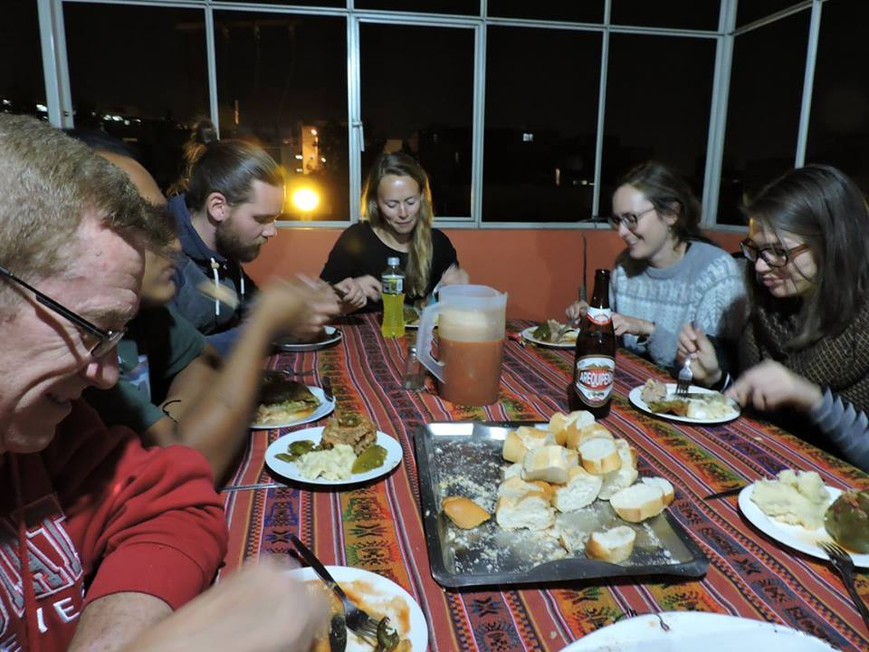
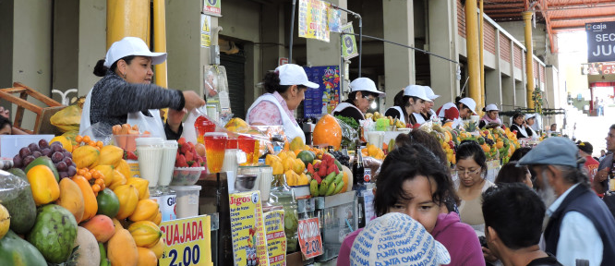
After work maybe go to the local market to buy cooking ingredients
Cook in pairs or sometimes as large groups and eat together on the terrace

Slide 9
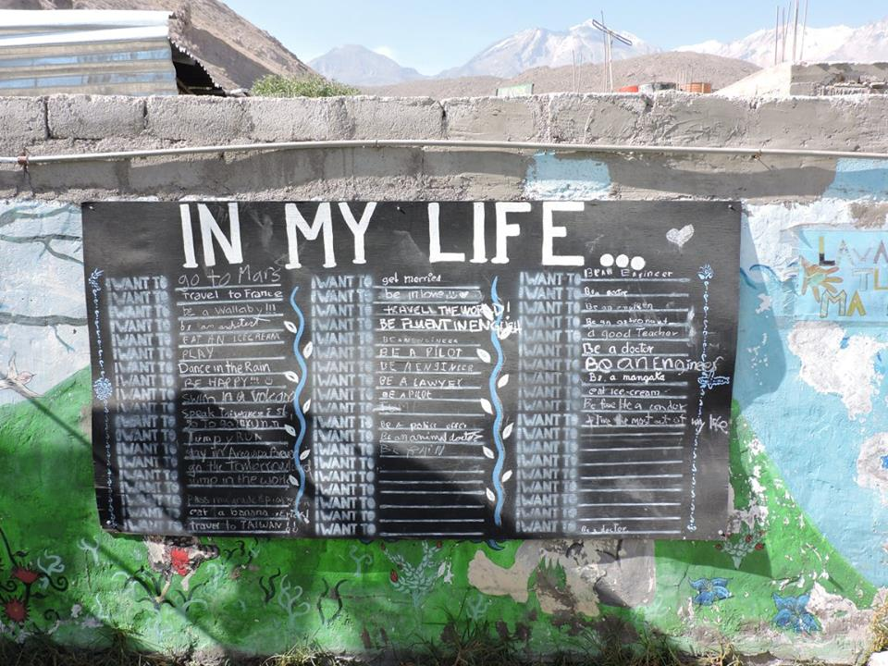
On Friday all office based volunteers went to school with teachers for lunch and to help with lessons, assembly and playtime

Slide 10
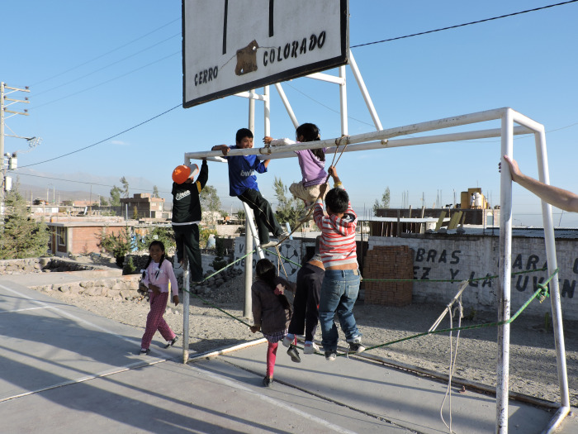
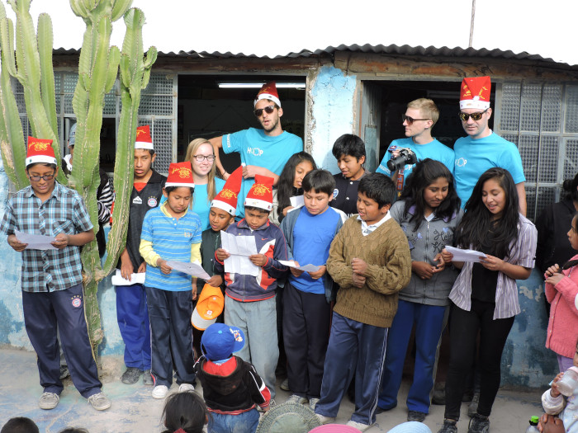
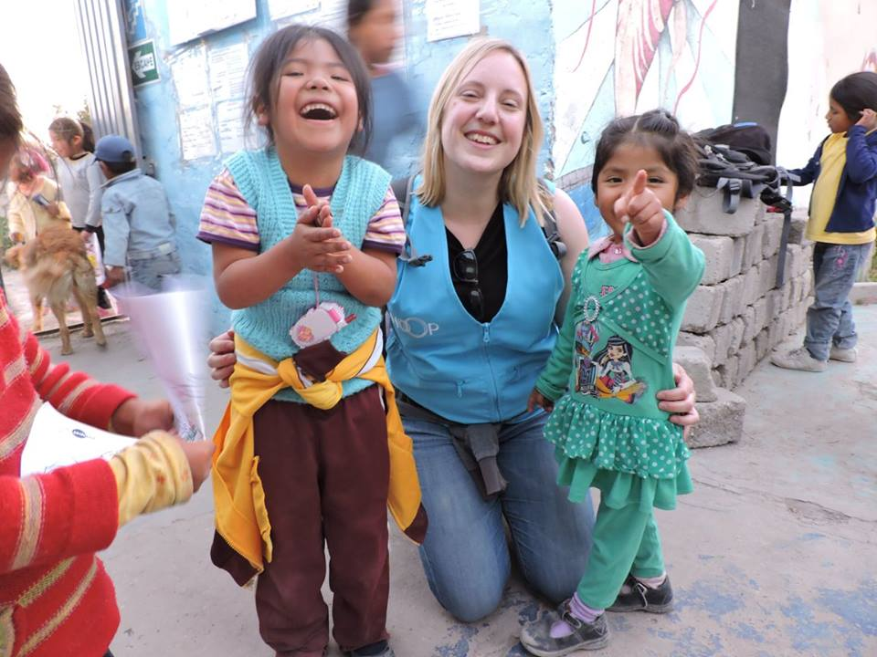
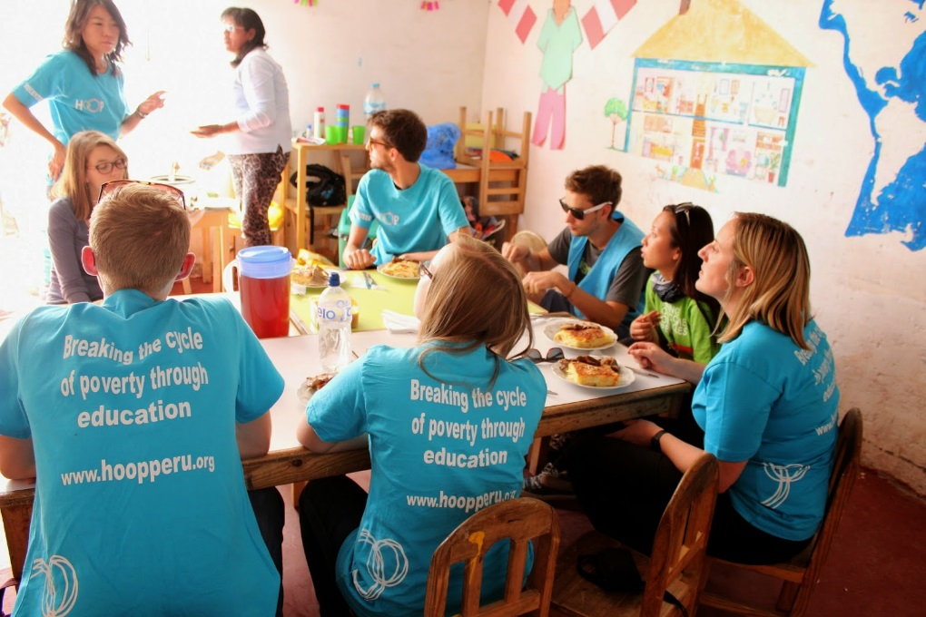

Slide 11
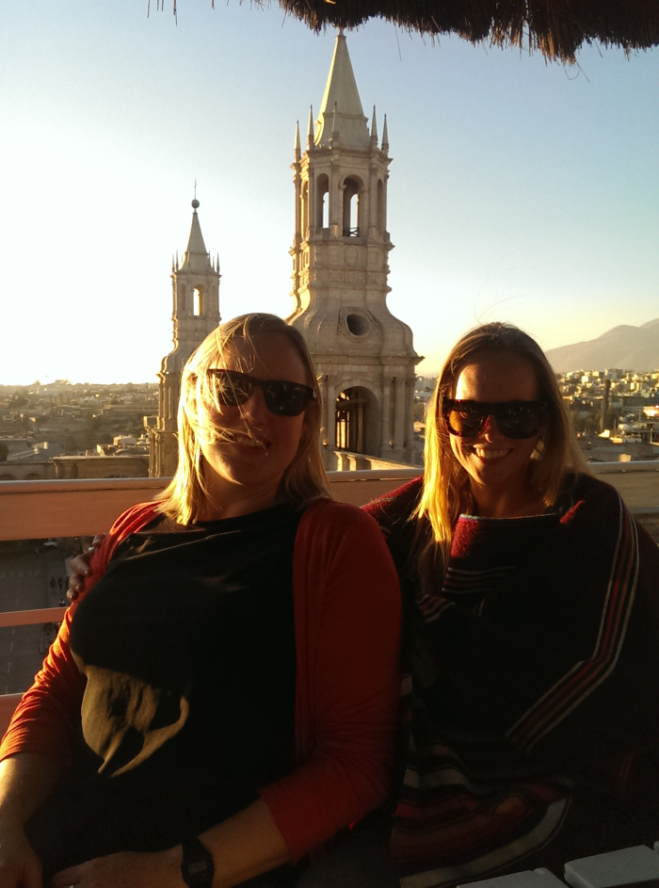
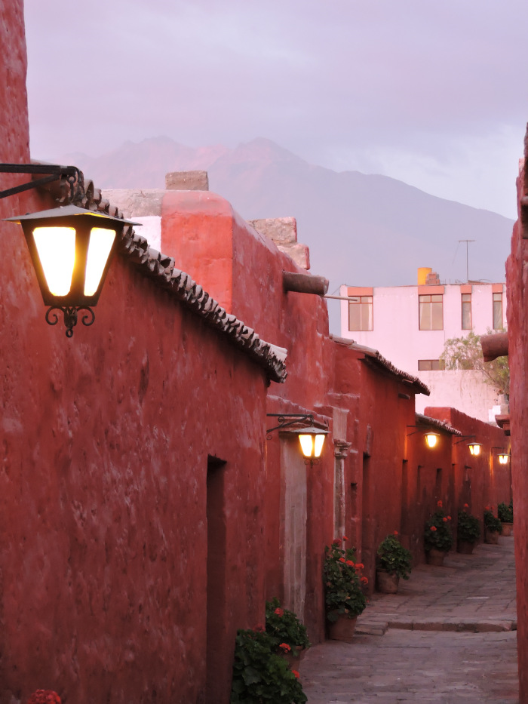
Evenings spent doing Spanish homework, exploring the city, watching films together or once a week hosting the quiz in another hostel

Slide 12
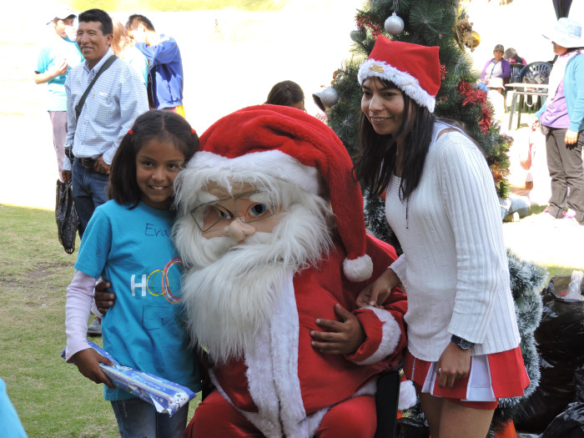
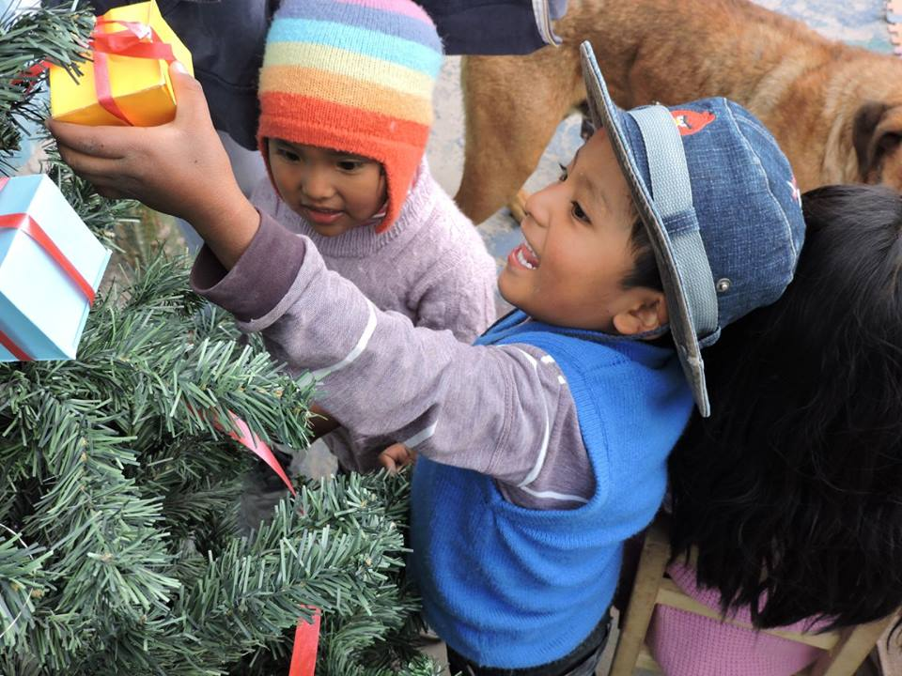
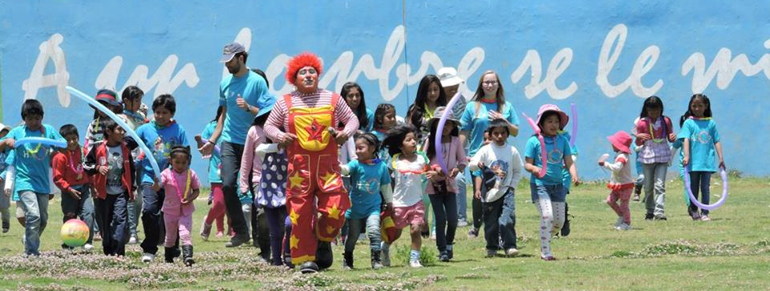
Xmas party

Slide 13
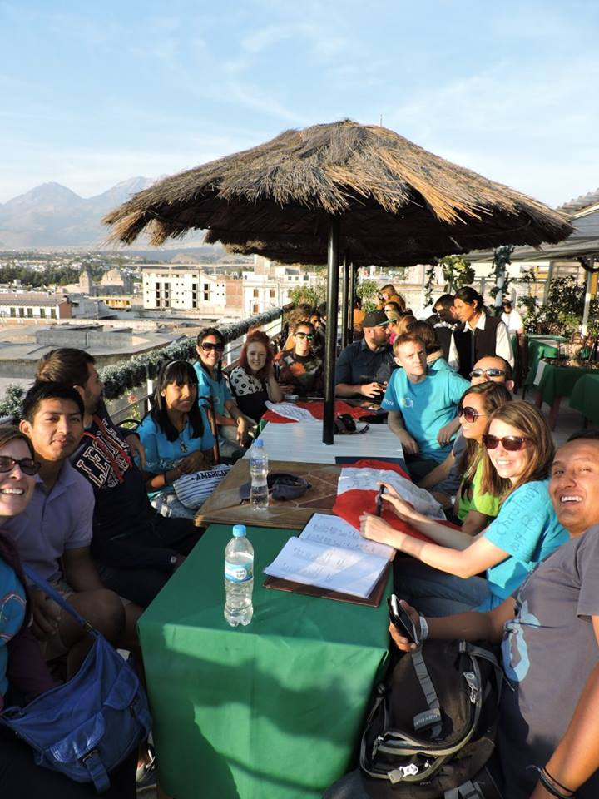
Other activities

Slide 14
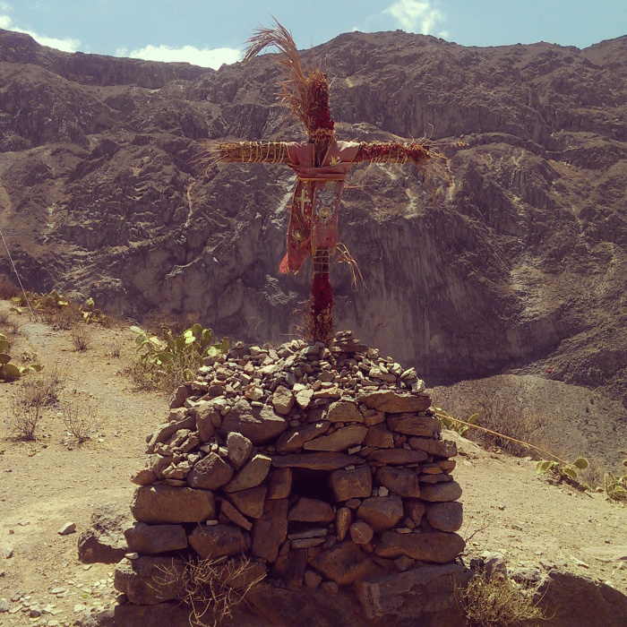
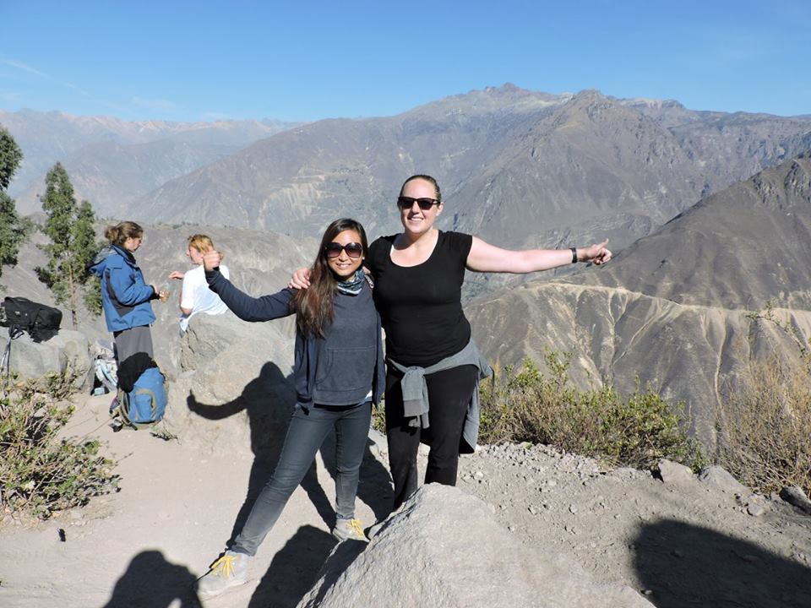
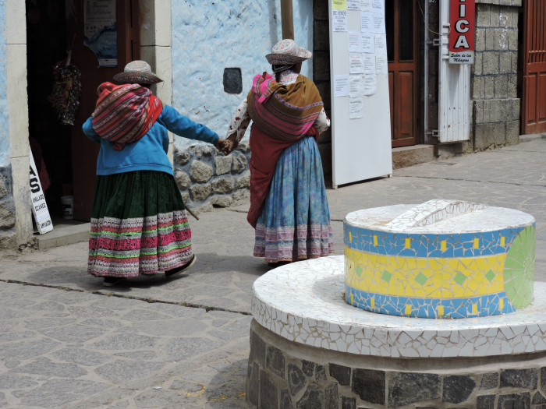
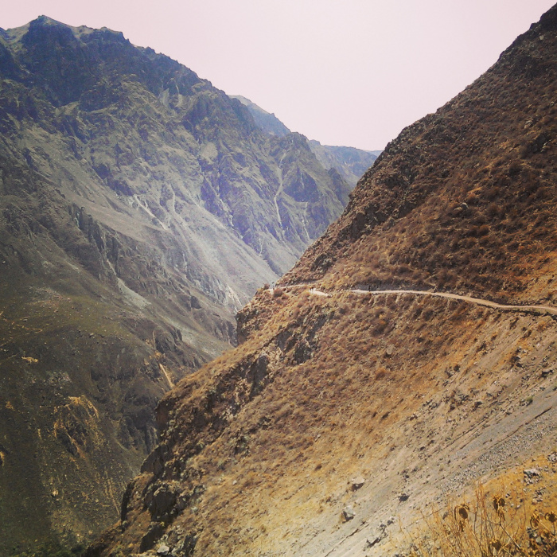
Colca Canyon

Slide 15
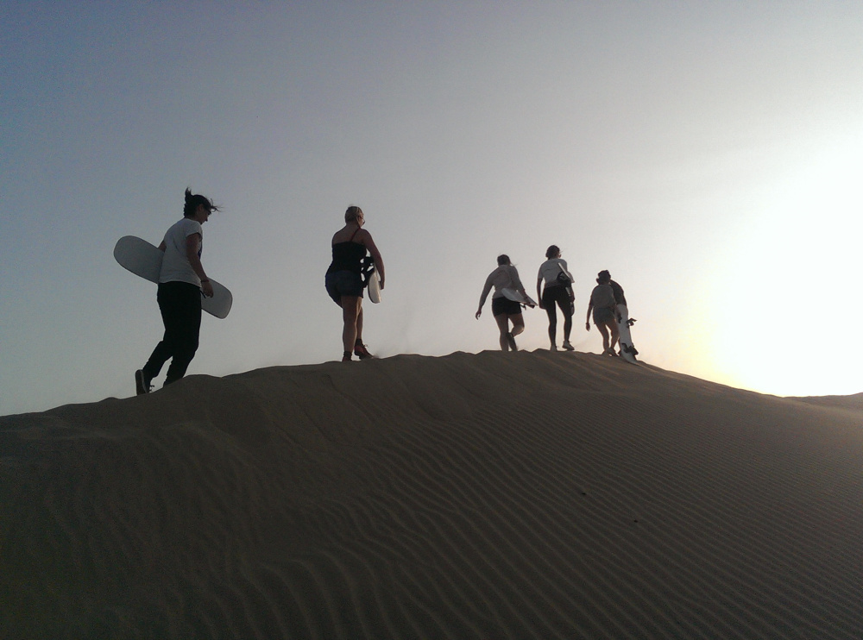
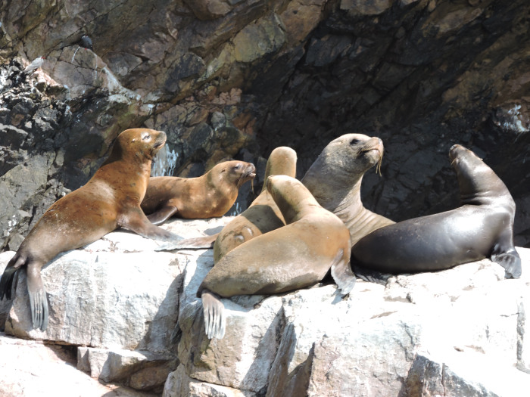
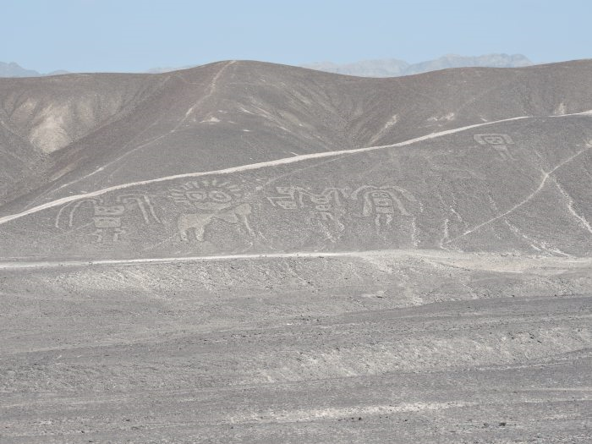
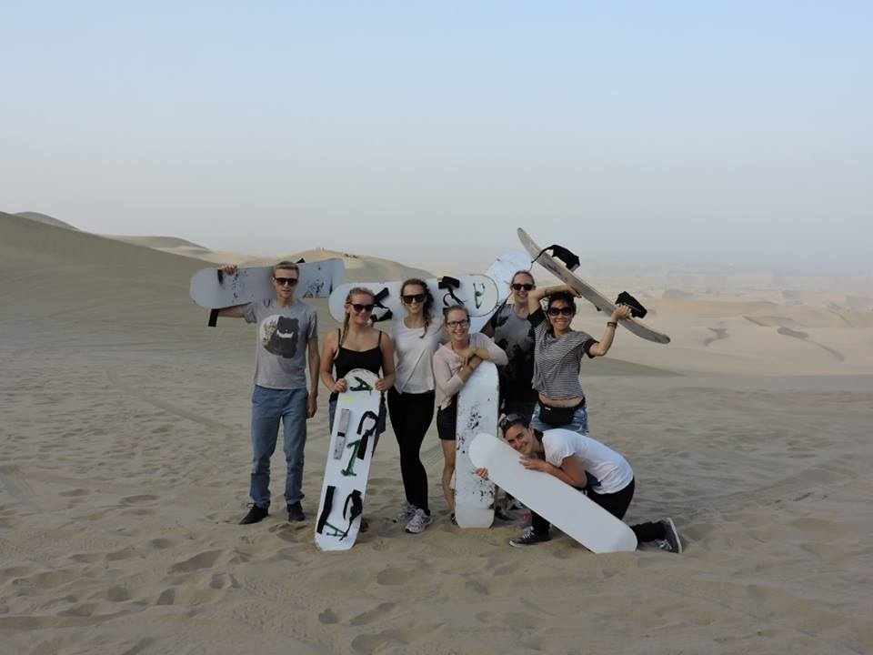
Huacachina, Nazca and Las Islas Ballestas

Slide 16
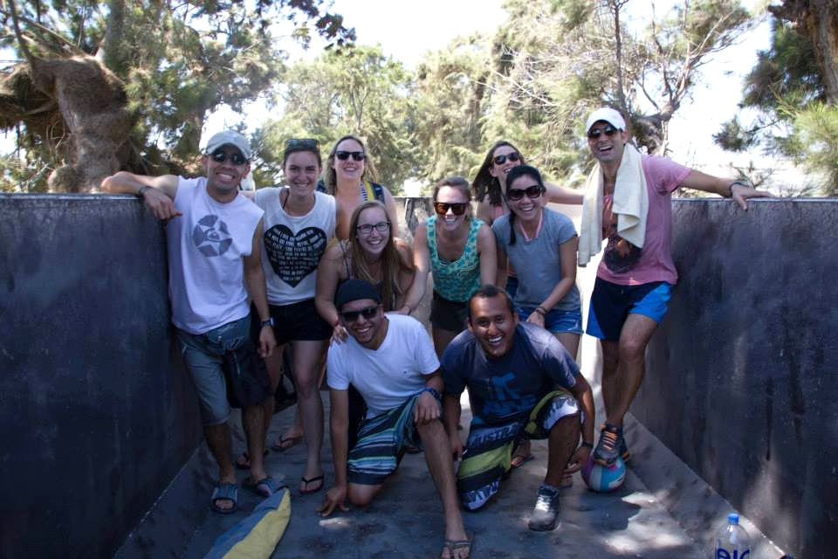
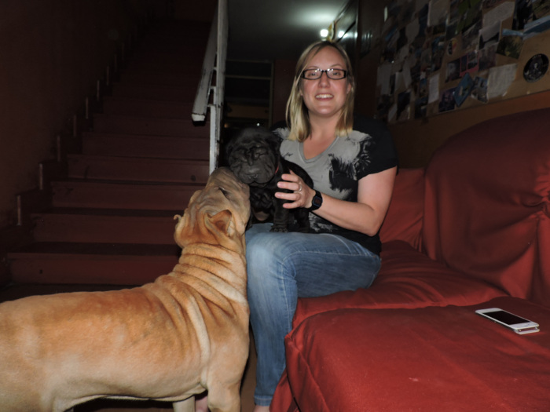
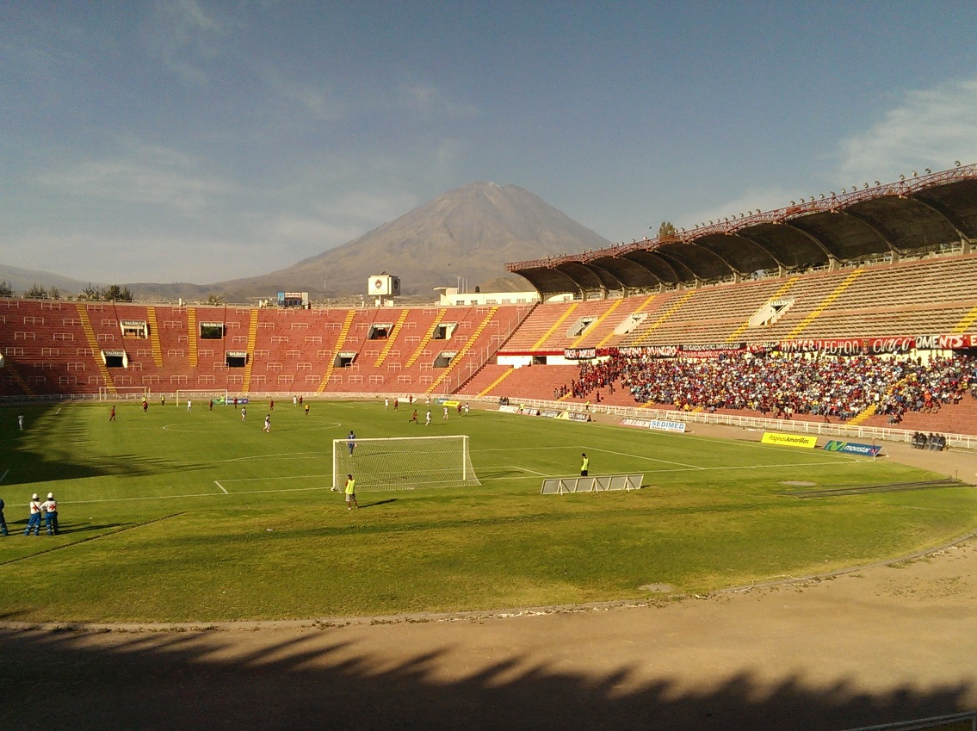
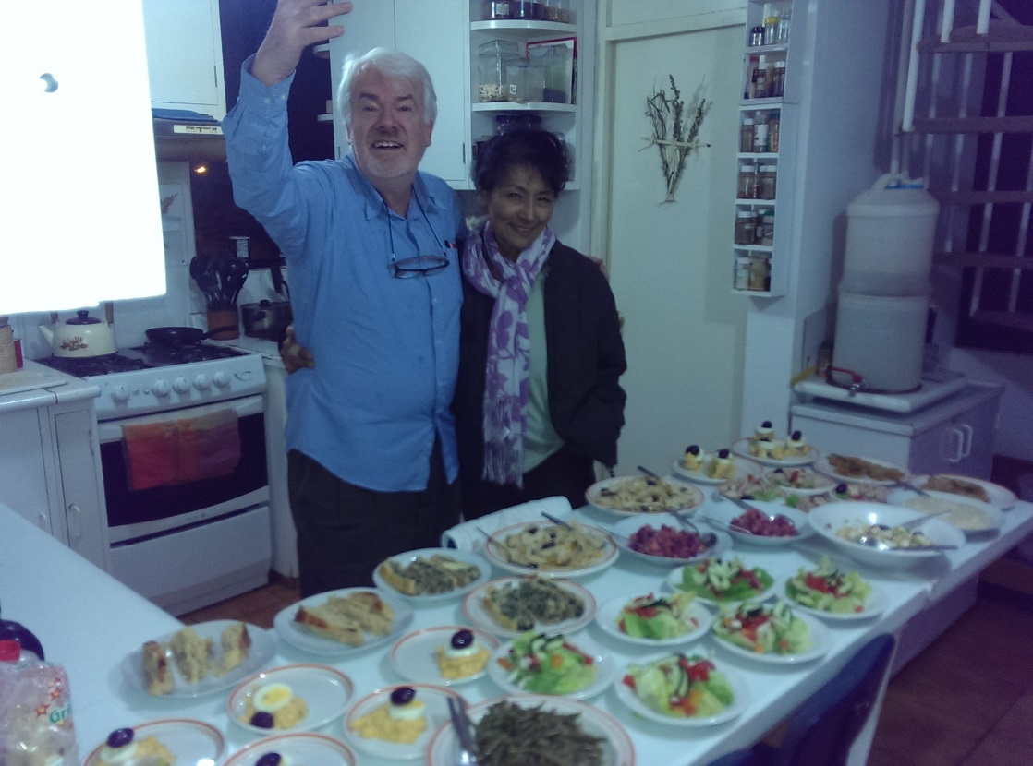
Hostel pets
Weekend beach trip
Dinner with my Spanish teacher
Football with a view

Slide 17
Memorable moments
Earned a new nickname – “Kate from London”
Karaoke nights with the locals
Learning to cook Peruvian food with the owners of the hostel
And a funny one…
During the weekend away being left asleep on the beach whilst others hid and sent a local lady to wake me up

Slide 18
What did I gain from the experience?
New friends the world over – already visited two in Taiwan, and hoping to meet up with a Peruvian visiting London later this year
Still in contact with staff and volunteers in Peru and would definitely like to visit again in the next couple of years
Haven’t moved to a job in the charity sector, but haven’t ruled it out either!
Carrying on with learning Spanish
Now a trustee and Treasurer of the UK HOOP organisation which we have recently managed to get registered as a charity and are planning next steps for fundraising

Slide 19
What advice would I give?
Think about what you would like to get out of the experience as well as what you can give
Enjoy the different culture and pace,​ especially as Finance staff may have multiple other responsibilities that may pull them away
Go with an open mind and a sense of adventure​
Enjoy it!

